Slide 1
영상 처리의 실제
Image Processing

Slide 2
Chap.1 Introduction
what is IP ?
  science of manipulating picture
four basic techniques of IP
  point, area, geometric, frame processes

Slide 3
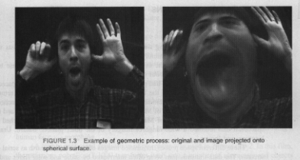
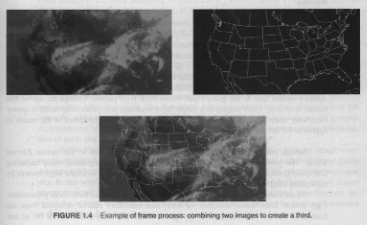

Slide 4
IP applications
  science and space
    space probes generate images of space
  movies
    image composition, morphing, image warping
  paperless office
    document image processing, optical character recognition
  medical industry
    CT (computer-aid tomography), MRI (magnetic resonance imaging)

Slide 5
  machine vision
    control manufacturing environment
  law enforcement
    fingerprint image analysis, facial image analysis
visual perception
  color -- chromaticity (light quality defined by wavelength)
  brightness -- luminance (amount of light)

Slide 6
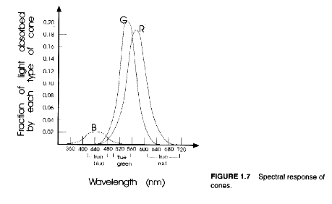
  two types of photoreceptors
    rods -- sensitive to light intensity
    cones -- detect color and fine details
      three types of cones -- blue,green, red

Slide 7
  three color variables
      hue -- distinguish colors,
      being related with wavelength
      saturation -- degree of how pure a color is
      lightness -- perceived intensity of reflecting object

Slide 8
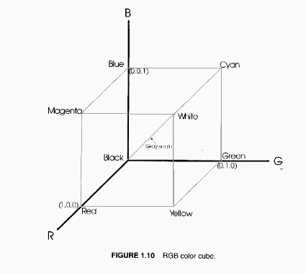
color representation
  RGB model
    used in CRT monitor and computer graphics
    gray value = 0.3R+0.6G+0.1B, or (R+G+B)/3

Slide 9
  CMY model
    used in publishing industry
  HSI model
    used in systems handling hue, saturation, and intensity
    modeled with cylindrical coordinates

Slide 10
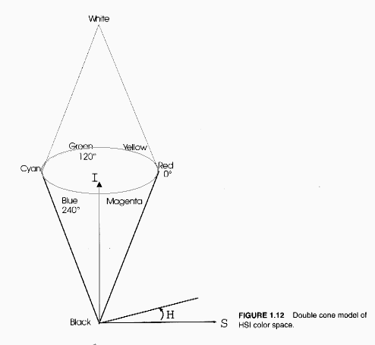

Slide 11
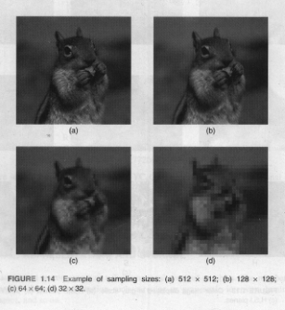
image capture, representation, storage
  digital image by sampling & quantization

Slide 12
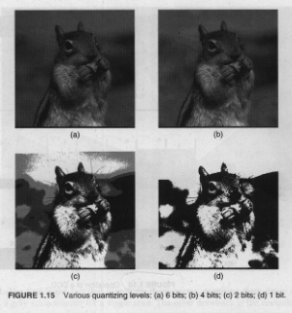

Slide 13
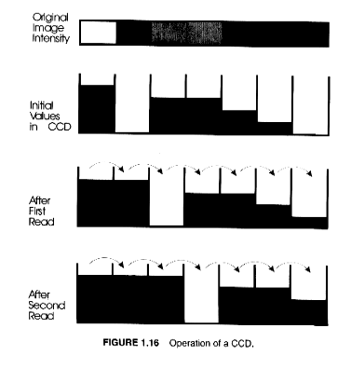
  CCD device
    generating electrical charges and moving them around

Slide 14
  frame grabber
    freezing video frame and then sampling and quantizing the image data
  color map
    look up table which associates pixel values with actual colors

Slide 15
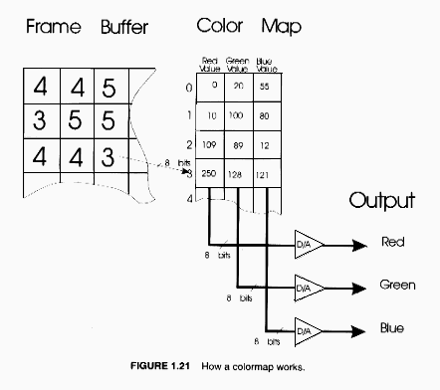

Slide 16
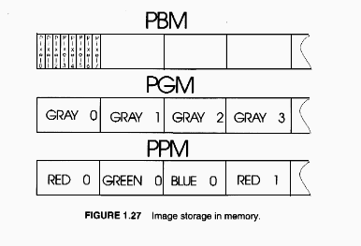
image output
  computer screen, various types of printers
software
  not optimized source code and images
  three formats of images
    PBM, PPM, PGM

Slide 17
Chap.2 Point processes
arithmetic operations
  adding, subtracting, dividing, and multiplexing pixels by constant
  When values become greater than 255, they are set to 255

Slide 18
XOR operation
  bit operation
  generate binary image where value of 0 is assigned to pixels whose value were the same as some constant mask
  often used to generate cursor
look-up tables
  use pixel value as array index
  not require repeated computation

Slide 19
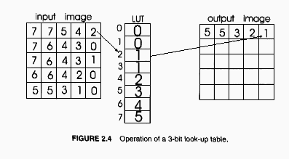

Slide 20
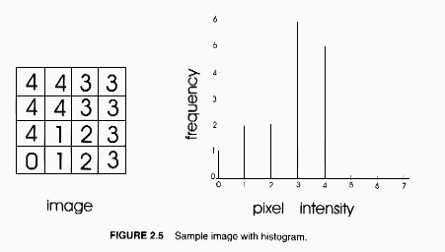
histograms
  view intensity profile of an image

Slide 21
  give information on contrast & overall intensity distribution of image
  used to determine range of pixels for objects or background

Slide 22
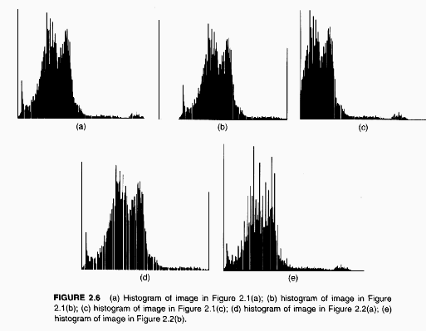

Slide 23
  histogram equalization
    try to obtain uniform histogram by spreading and shrinking
      (1) compute histogram
      (2) calculate normalized sum of histogram
      (3) transform input image to output image

Slide 24
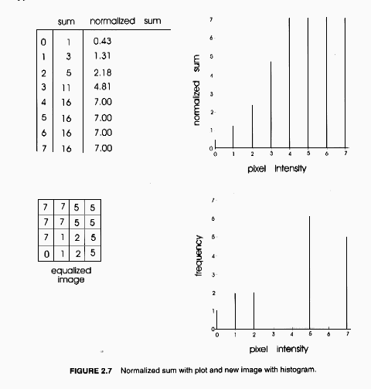

Slide 25
    work well on images with fine details in dark regions
  histogram specification
    lighten or darken an image, or make more contrast of an image
    require desired histogram and input image
    histogram equalization + inverse histogram equalization

Slide 26
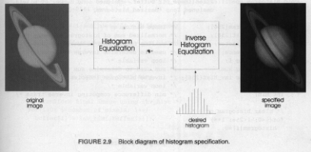
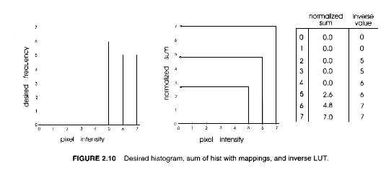

Slide 27

contrast stretching
  low contrast image has pixels cover only some portion of grayscale
  high contrast image utilizes full range of scales
  enhance low contrast images by stretching histogram to fill full range of scales
    basic contrast stretching - work well when all pixels cover on some portion of scales

Slide 28
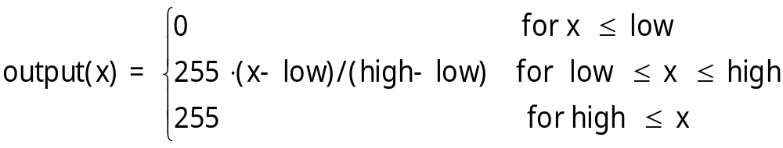
    ends-in-search - work well when pixels cover all range of scales but concentrated on some portion of scales
intensity transformation
  convert pixel values based on predefined function
  null and negative transformation

Slide 29
  gamma correction
    used to compensate for nonlinear responses in sensors, displays and film
  contrast stretching and compression
  posterizing
    reduce number of gray-levels

Slide 30
chap3. area processes
convolution
  weighted sum of pixels in a neighborhood of source pixel

Slide 31
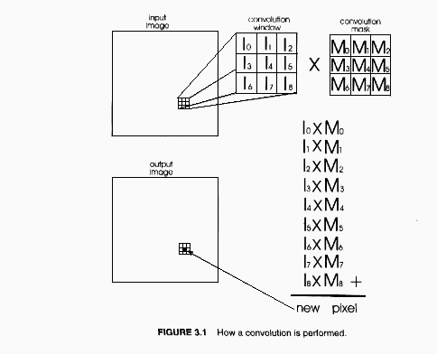

Slide 32
  how to treat border pixels?
    zero padding - treat empty pixels in a window as zeros
    start convolving at first position where a window overlap an image
    enlarge image by duplicating border pixels

Slide 33
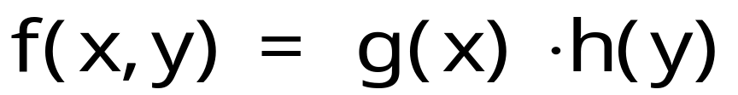
    enlarge image by wrapping itself around
  computational load depends on the size of mask
  separable mask
    reduce computation
  embossing an image
    make image look like etched on a nickel sheet
    use mask which has center weight of 0 and sums to 0

Slide 34
  how to convolve color image?
    convolve intensity component of HSI image
    convolve each channels of RGB image
blurring
  remove finer details of image
    lowpass filtering
  all coefficients are equal, simple averaging
    1/9 in 3x3 mask
    reduce gaussian noise, but lower the contrast
  use the mask of gaussian kernel

Slide 35
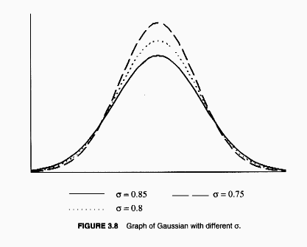

Slide 36
sharpening
  emphasize details in an image
    highpass filtering
  positive coefficient in center and negative coefficients around outer edges
  highpass = original - lowpass
    tend to amplify noises
  high_boost = αoriginal - lowpass
    when α>1, restore some of low frequency components

Slide 37
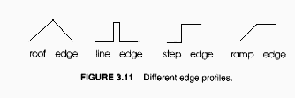
edge detection
  intensity changes rapidly around edges
  different edge profiles

Slide 38
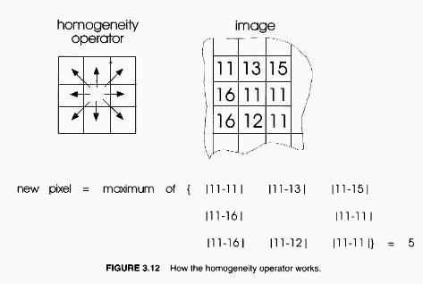
  homogeneity operator
    subtract surrounding pixels from center pixel and choose the maximum

Slide 39
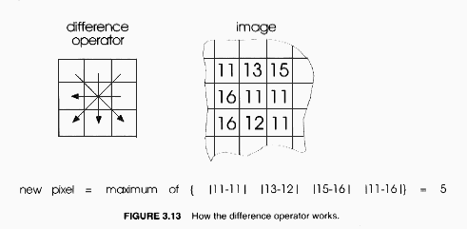
  difference operator
    subtract surrounding pixels from their opposing counterparts and choose the maximum

Slide 40
  thresholding an edge map
    may use single threshold or double threshold

Slide 41
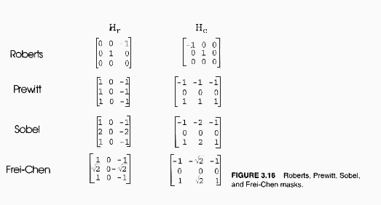
first-order derivative (gradient operator)
  use row and column detectors

Slide 42
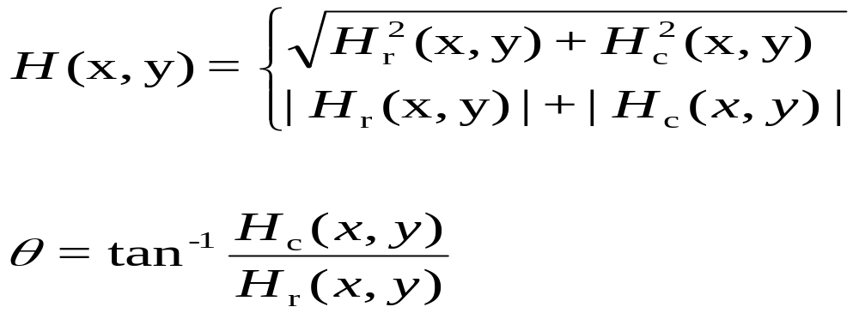
  mask coefficients sum to 0
  edge amplitude and orientation
    roberts operator - sensitive to noises
    sobel operator - sensitive to diagonal edges
    prewitt operator - sensitive to veti. & hori. edges

Slide 43
compass gradient operator
  directional operator
  choose maximum of 8 directional convolutions
second-order derivative operators
  help to get one pixel width closed contours
  laplacian operator
    omnidirectional operator
    zero-crossing (sign change) at edge points
    very susceptible to noises
      may need threholding with edge magnitude

Slide 44
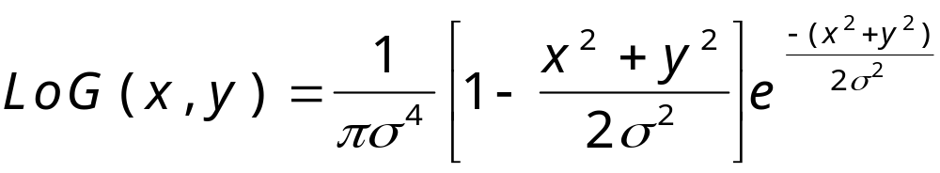
  laplacian of gaussian

Slide 45
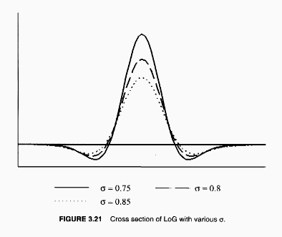
have a shape of Maxican hat

Slide 46
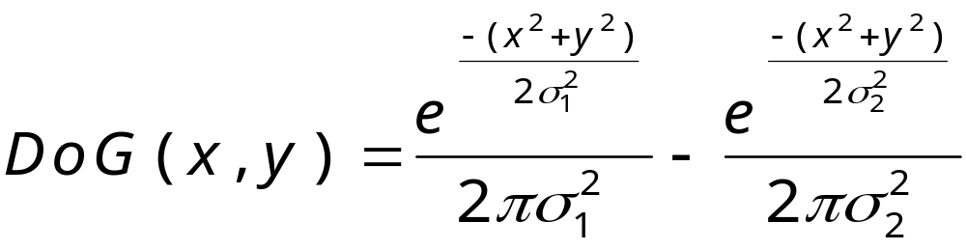
    width of positive lobe = 2x1.414xσ
    width of mask >= 8.49xσ
  difference of gaussian
    approximate LoG

Slide 47
color edge detection
  apply operator to intensity channel of HSI space
  apply operator to each of R, G, B channel
median filtering
  suited for removing impulse noise while preserving sharp edges and details
  operation of median filter

Slide 48
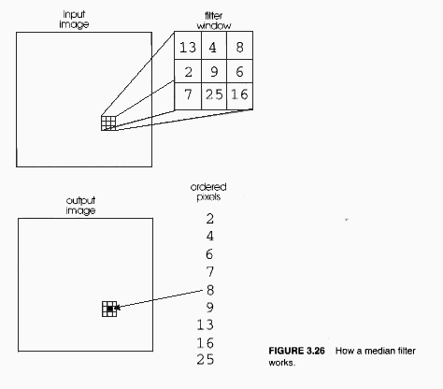

Slide 49
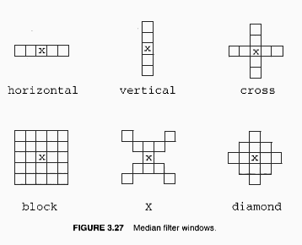
  types of windows

Slide 50
  temporal median filter
  separable block median filter
    horizontal followed by vertical median filtering
  color median filtering
    treat each channel separately and combine the results
      cause problems of shifting edge points

Slide 51
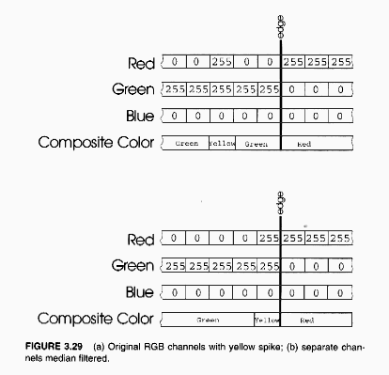

Slide 52
minimum/maximum filtering
  replace center pixel with min or max window value
  minimum filter removes white spikes
  maximum filter removes dark spikes
  cascade of max and min filters remove white & dark spikes (salt & pepper noise)

